Slide 1

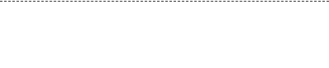
Final project for Deep Learning for Computer Vision
REAL-TIME
ROCK PAPER SCISSORS
PRESENTED BY THE 💻COMPUTER VISIONARIES✨
Parsa Bakhtiari, Gaia Iori, Ilia Koldyshev

Slide 2







MISSION OBJECTIVE
Create an AI that reads human intention. The goal is to build an agent for Rock-Paper-Scissors that recognises the gestures and predicts the opponent's move before it happens and wins 100% of the time.
TEMPORAL DYNAMICS
SPATIAL FOCUS
PRE-EMPTIVE PREDICTION
A gesture is a process, not a static image. We need to analyze the evolution of the hand movement over time, not just the final shape.
The input contains noise (face, background, clothes). We must detect, track, and crop the hand in real-time to feed the model purely relevant data.
Standard recognition is too slow. The agent must infer the gesture during the 'wind-up' phase (early timestamps) to react faster than human perception

Slide 3



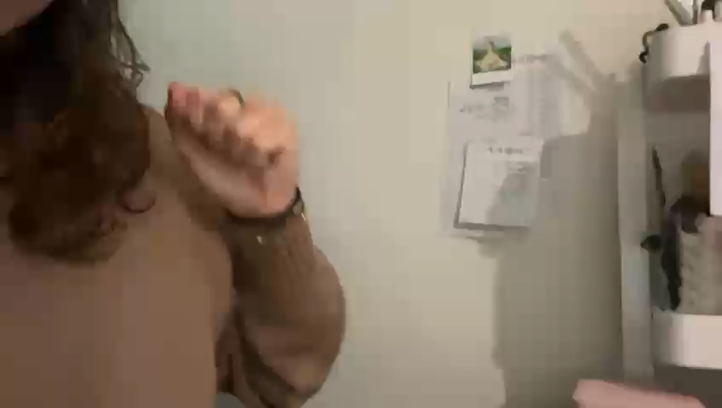


DATA COLLECTION
SOURCE: Raw video sessions of RPS gesture performance.
PROCESS: ffmpeg used to parse the videos.
AUDIO: Removed audio from all videos.
FRAMES: Every 20/30 fps extracted a frame
OUTPUT: Labeled frame dataset (Rock/Paper/Scissor).
> EXECUTING SCRIPT: Video2frames.ipynb... > STATUS: COMPLETE
DATA AUDIT: the gestures aren’t defined enough. Extra data engineering needed.

Slide 4

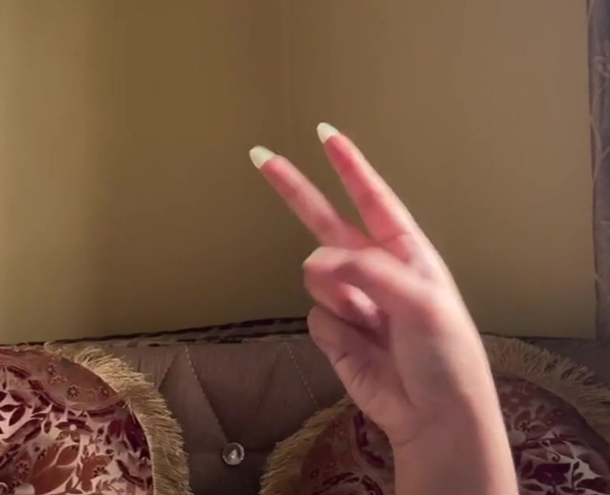
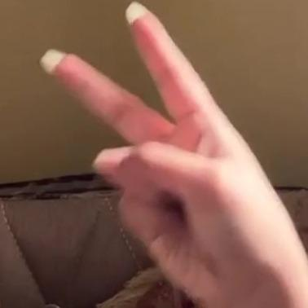
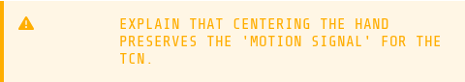

DATA PREPROCESSING
PROTOCOLS
Problem: the gesture is a small part of the frames.
PROTOCOL 1: DETECTION
Roboflow API: integrated to locate bounding box containing the hand.
Phase I: Implemented a "Static Hold", which assumed the hand was stationary.
PROTOCOL 2: TRACKING
Velocity Smoothing: Predictive positioning during flicker.
Phase II: Linear Extrapolation using velocity vectors.
Output: tightly cropped, centered sequences of hands.
> EXECUTING SCRIPT: data_splitting.py ... > STATUS: COMPLETE

Slide 5
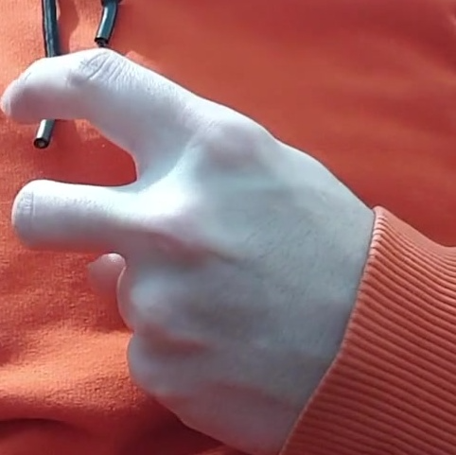

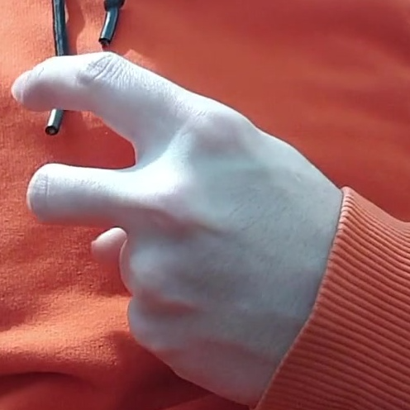
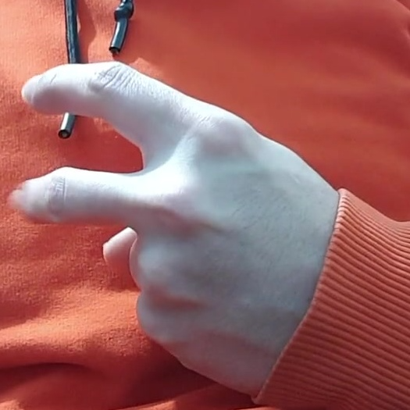
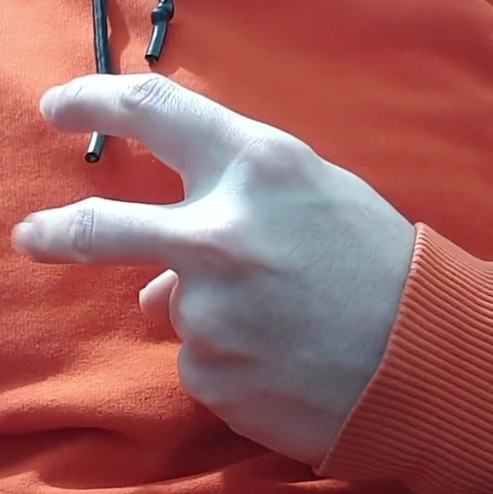
MORE DATA ENGINEERING
Problem: Data leakage
Problem: training on YOLO crops but deploying with MediaPipe.
PROTOCOL 3: LEAKAGE PREVENTION
PROTOCOL 4: PRODUCTION ALIGNMENT
Video-Level Splitting: Implemented Stratified Video-Level Splitting to group files by Video ID.
Phase III: 70% Training, 15% Validation, and a 15% "Black Box" Test Set for unbiased metrics.
Video-Level Splitting: Standardized the data generation pipeline to use MediaPipe Hands, ensuring training inputs are geometrically identical to live inference inputs.
Augmentation: random rotations, horizontal flips, and color jitter
Notes:
picture with example of og + cropped

Slide 6

THE EVOLUTION PIPELINE
PHASE I: THE 'EYE' (SPATIAL FEATURES)
PHASE II: THE 'BRAIN' (TEMPORAL CONTEXT)
PHASE III: OPTIMIZATION (SOTA PERFORMANCE)
Evolution from Custom CNN to ResNet-18.
Replaced custom CNN with pre-trained ResNet-18. Extracts 128-dim feature vector per frame. Fine-tuned final 4 layers for hand features. Accuracy went from 60% to 80%
Challenge: Every gesture starts as rock. Static analysis fails here.
TCN (Temporal Convolutional Network) tracks the change over time to distinguish a holding Rock from a starting Paper.
Sliding kernels analyze motion dynamics.
Optimization of the hyperparameters
Fine tuning the parameters (Kernel size = 6, Seq Len = 64, Layers = 4) pushed final accuracy.
The accuracy improved at around 86.7% + early prediction
Notes:
2 min

Slide 7
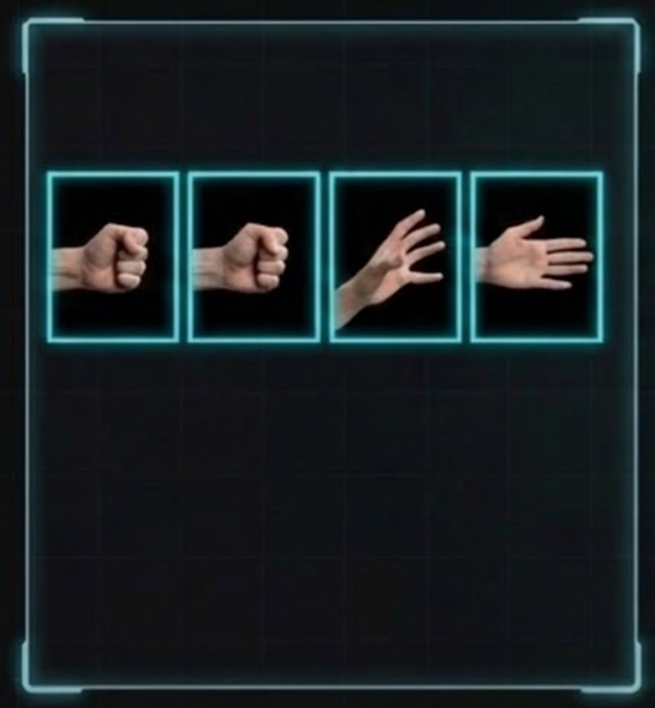
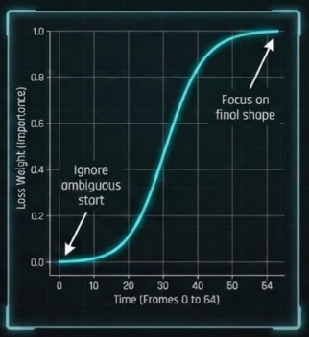
OPTIMIZATION STRATEGY
THE PROBLEM
THE SOLUTION
THE "ROCK PARADOX" (VISUAL EVIDENCE)
SIGMOID TIME-WEIGHTED LOSS
frame 0 frame 4 frame 8 frame 12
model sees rock
ground truth: paper
Without temporal context, the start of every move looks like Rock
Notes:
0.5 min

Slide 8
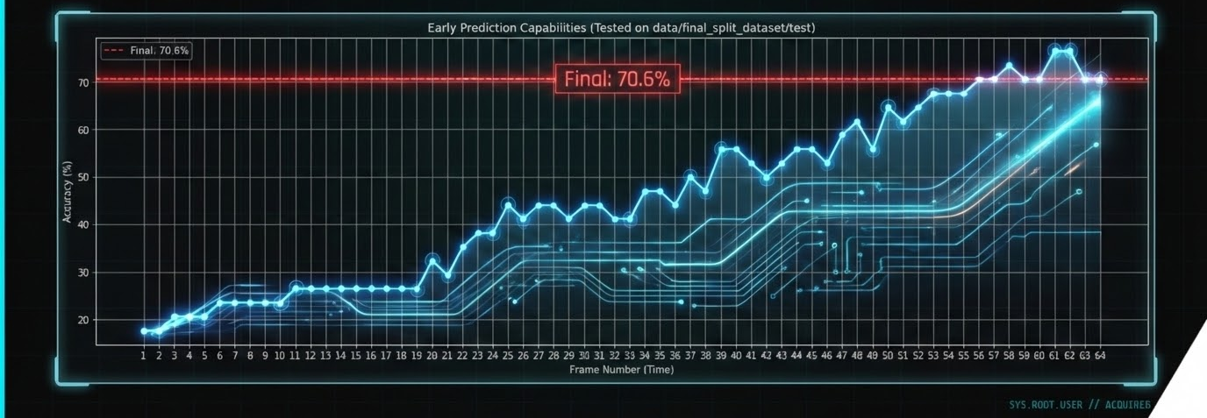
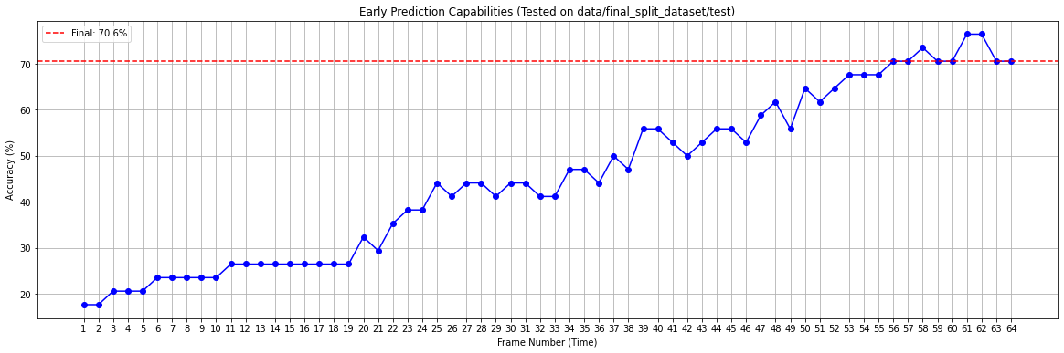
EARLY PREDICTION AND EVALUATION
KEY FINDING : The model doesn't just guess; confidence rises over time
METRIC : Accuracy per frame timestep
Notes:
0.5 min

Slide 9
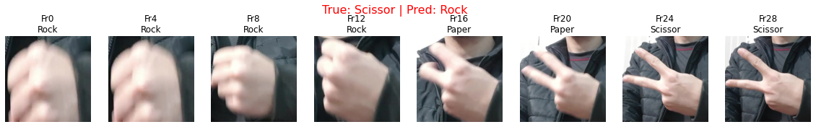
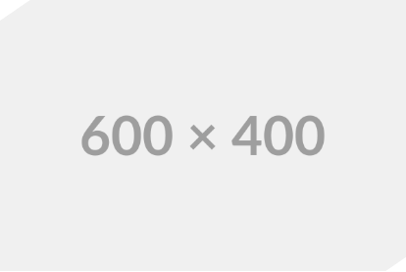
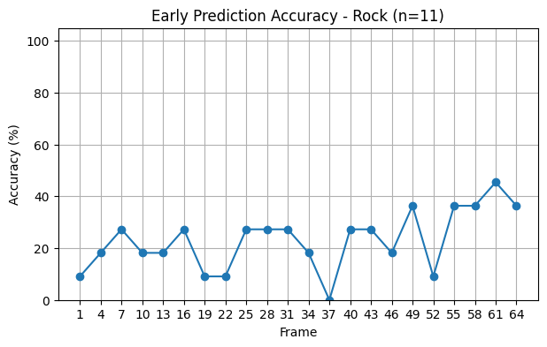
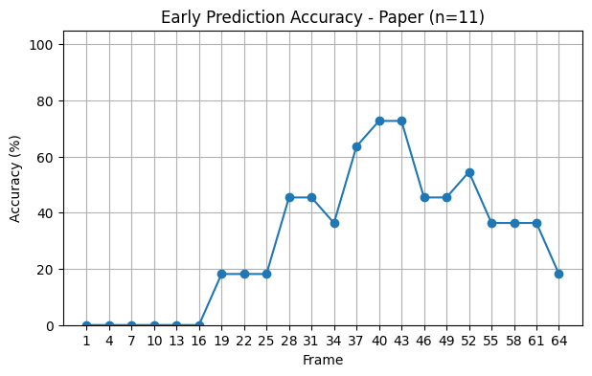
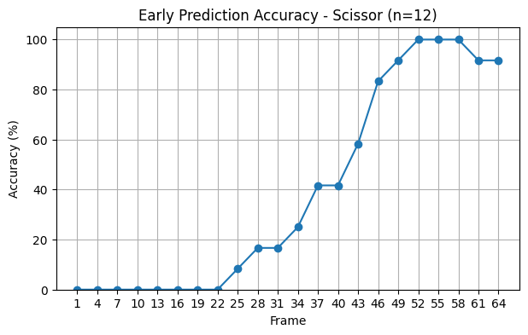
EXAMPLES & METRICS
> EXECUTING SCRIPT: live_battle.py…
> STATUS: PLAYING...

Slide 10


LIVE GAME ANALYSIS
NOW PLAYING: ROCK PAPER SCISSORS
LOADING THE VIDEO DEMONSTRATION
Notes:
qua magari aggiugnere video del gioco in funzione

Slide 11
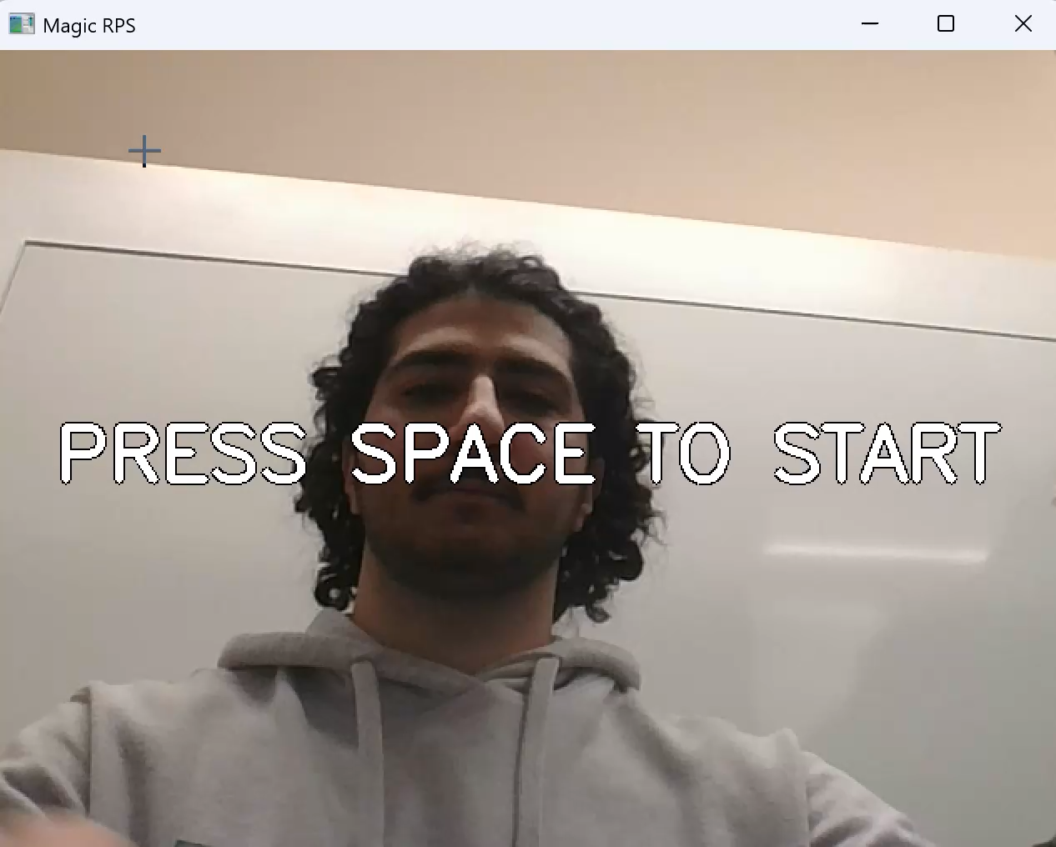
Notes:
qua magari aggiugnere video del gioco in funzione

Slide 12
MISSION ACCOMPLISHED & NEXT STEPS
CURRENT STATE
Successfully built the pipeline from raw videos to deep learning model that understands the timing of the game.
ENGINEERING TRICKS
MediaPipe Integration: "Added skeletal tracking for robust hand detection (Rock vs. Background) and cheat detection."
Cognitive Timing: "Prediction triggers at 3.8s (200ms pre-GO) to exploit human reaction time."
Stream Processing: "Rolling buffer of 64 frames (Zero Lag) vs. Batch Processing"
PATCH NOTES (FUTURE)
[ ] Train: obtain more diverse environment dataset
[ ] Adaptive Difficulty and Speed: "Model learns specific opponent's patterns over multiple rounds."
[ ] Multi-Gesture Support: "Expand to Lizard/Spock or other hand signs."
Notes:
what possible pic? maybe something artistic for rps

